Slide 1
COLLABORATIVE UNIVERSITY ANDROID APP
Adeel Asghar
Palak Patel
Hala Ali
Tyler Gross
Notes:
Present: Adeel

Slide 2
Prototype 1 Feature Implementations
CI/CD Jenkins Build Automations
MVVM Architecture
Main Forum
Login/Register Activities
Dependency Injection and Dagger
Firebase Realtime Database
NoSQL Database Schema
Notes:
Present: Hala

Slide 3
Prototype 2 Feature Implementations
CI/CD Jenkins Test Reports
Create and Delete Posts
Create and Delete Comments
Subscribe to Main Forum
See User Profile
NoSQL Database Schema
Notes:
Present: Palak

Slide 4
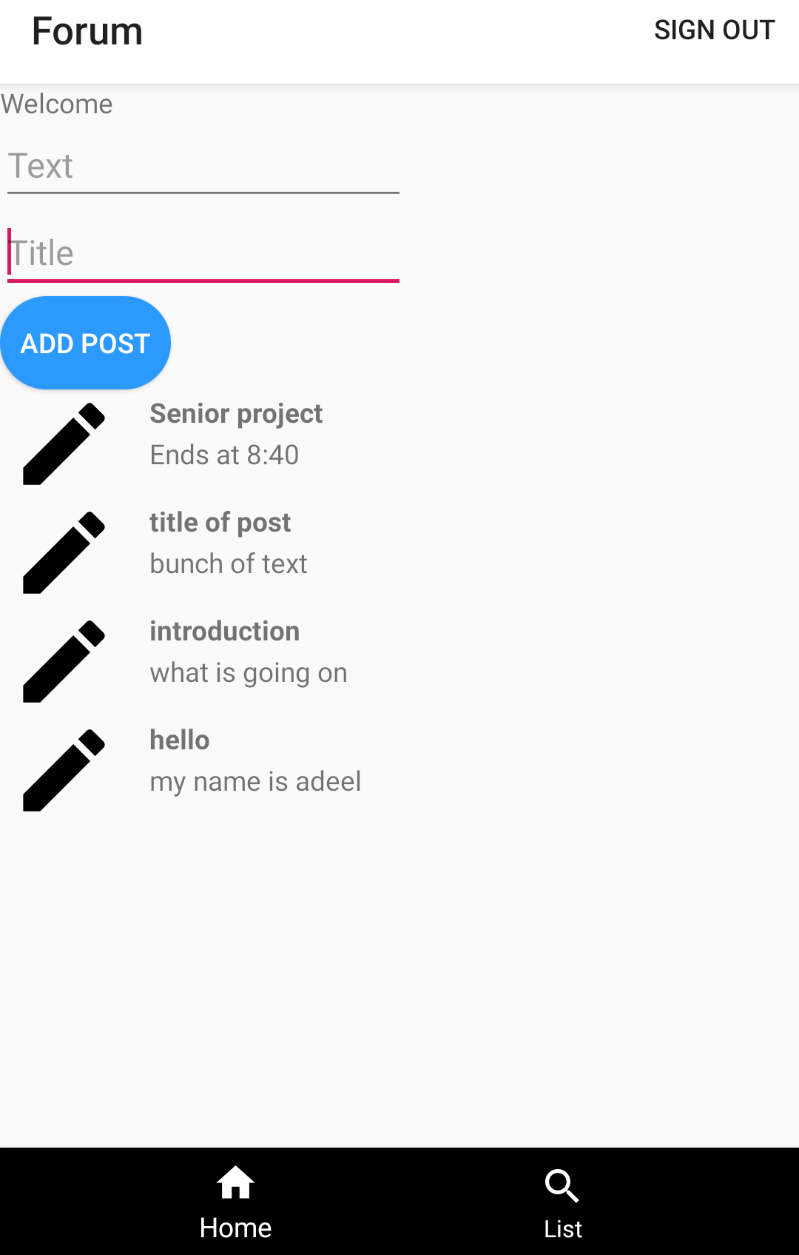
Prototype 1 Screenshot
Notes:
Present: Palak

Slide 5
DEMO
Notes:
Present: Adeel

Slide 6
Next Steps
Create Private Chat Messaging
Implement Coroutines with Kotlin Flow API using Observable Booleans
Complete all Test Cases with MockK framework
Sorting Posts with Filters
Search for Class Forums
Enhance UI/UX Experience
Implement Real-time Updates
Add Shared Flashcards
Add Image Post
Add Likes
Notes:
Present: Tyler

Slide 7
Questions?
Notes:
Present: Tyler

